Slide 1

WIPRO NGA Program – Selenium
Capstone Project Presentation -2025
Project Title - Automated tests using Selenium with for an E commerce website
Presented by – Akshay Bollam (24648)
www.rpsconsulting.in

Slide 2

Table of Contents
Introduction
Objective
About the application
Testing process
Major functionalities automated
Sample feature files
Project structure
Screenshots of test cases, reports
Conclusion
2025 - RPS Consulting all rights reserved

Slide 3

Introduction
This project automates an E-commerce website using Selenium WebDriver.
It follows a hybrid automation framework combining POM, TestNG, and Cucumber (BDD)
The goal is to ensure efficient, reliable, and maintainable test automation
2025 - RPS Consulting all rights reserved

Slide 4
Objective
To develop a robust and scalable automation framework.
Improve test execution efficiency through parallel testing and CI/CD integration.
Ensure high test coverage for major functionalities.

Slide 5
About the Application
The test website is designed for automation practice.
It includes user registration, login, product search, cart management, and order processing.
The project consists of 26 automated test cases for different user scenarios.

Slide 6
Testing Process
Requirement Analysis – Understanding the test scenarios.
Test Case Design – Writing BDD feature files using Gherkin syntax.
Test Script Implementation – Developing scripts using Selenium, TestNG, and Cucumber.
Execution & Reporting – Running tests and generating Extent Reports
CI/CD Integration – Running tests via Jenkins for continuous testing.

Slide 7
Major Functionalities Automated
Product Search & Filtering
User Registration & Login
Product Search & Filtering
Cart Management (Add , Update, Remove Products)
Order Placement & Checkout
Payment & Invoice Generation
Subscription & Contact Us Form Automation

Slide 8
Sample Feature Files
Uses Cucumber BDD With Gherkin Syntax for Better Readability
Example Scenario
Scenario: Register a new user
Given I launch the application
When I enter user details
And I submit the registration form
Then I verify the account is created successfully

Slide 9
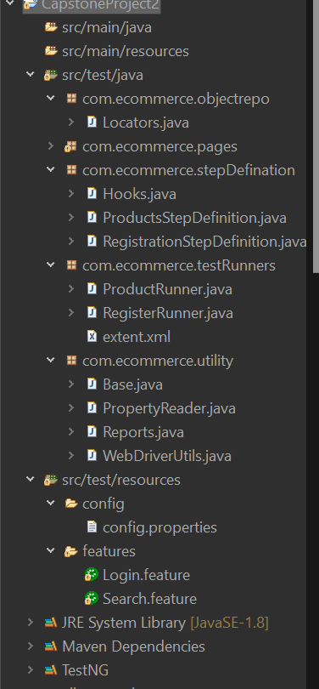
Project Structure

Slide 10
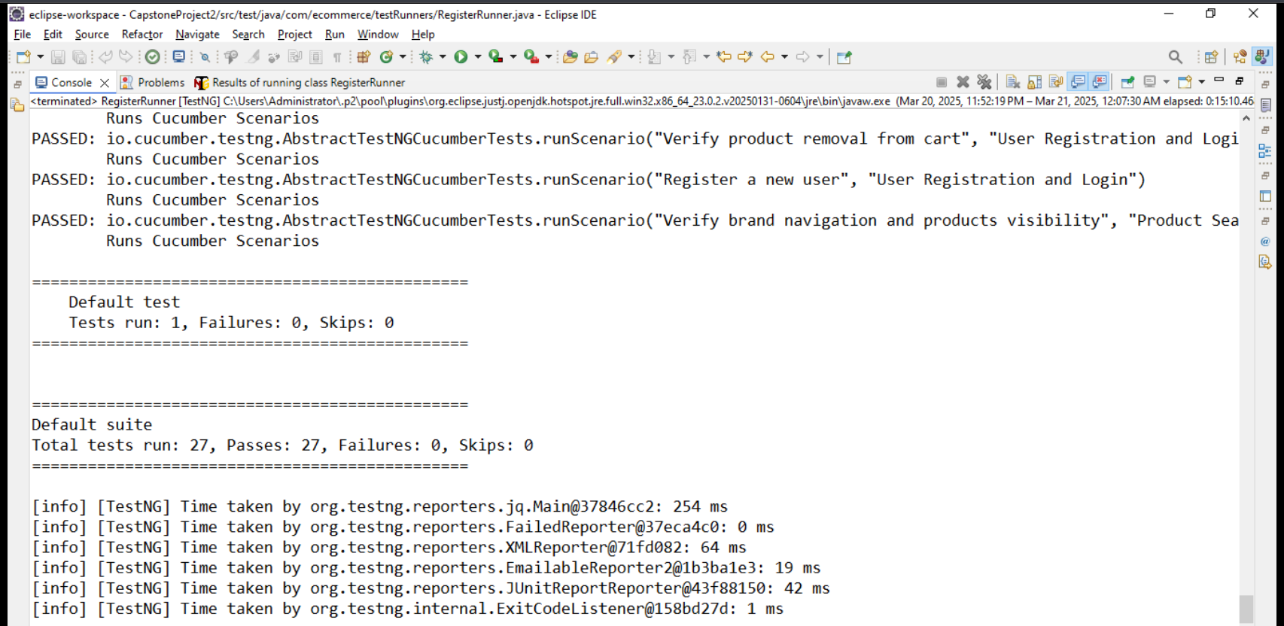
Screenshots of Test Cases, Reports,

Slide 11
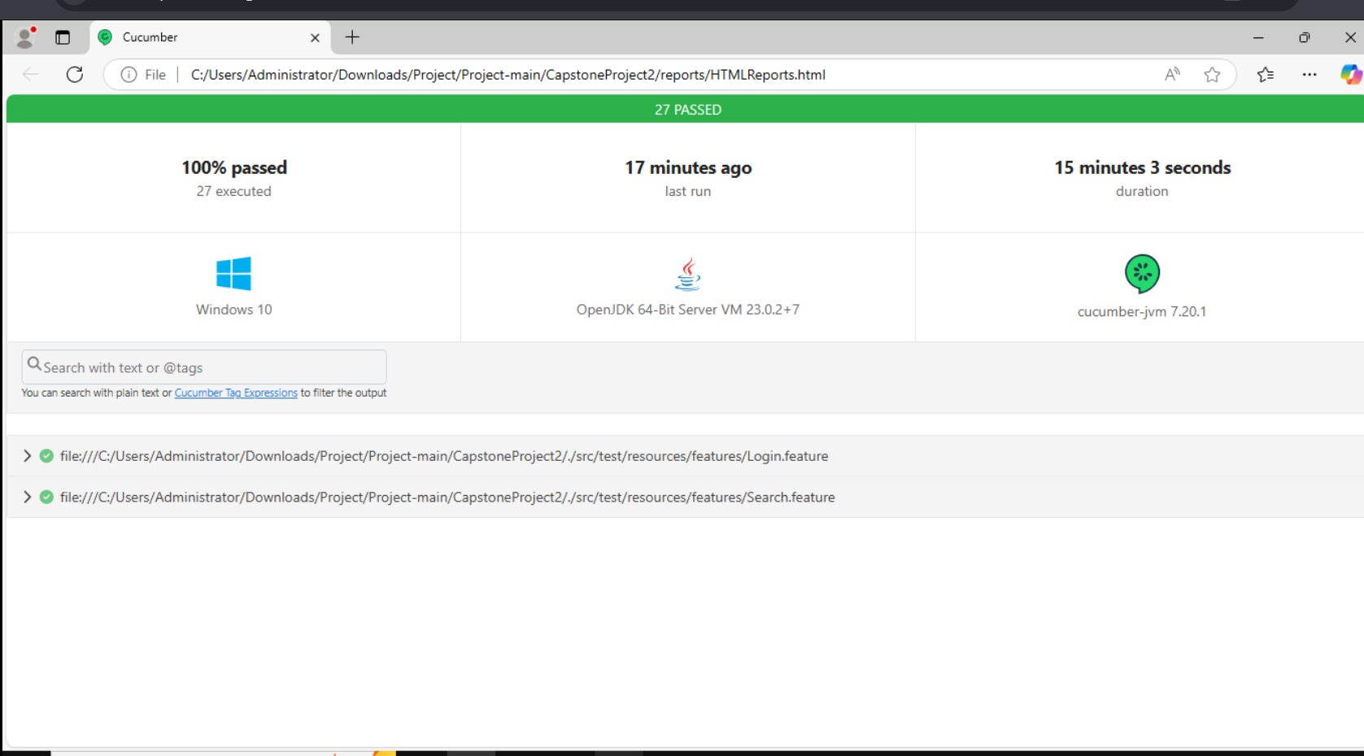

Slide 12
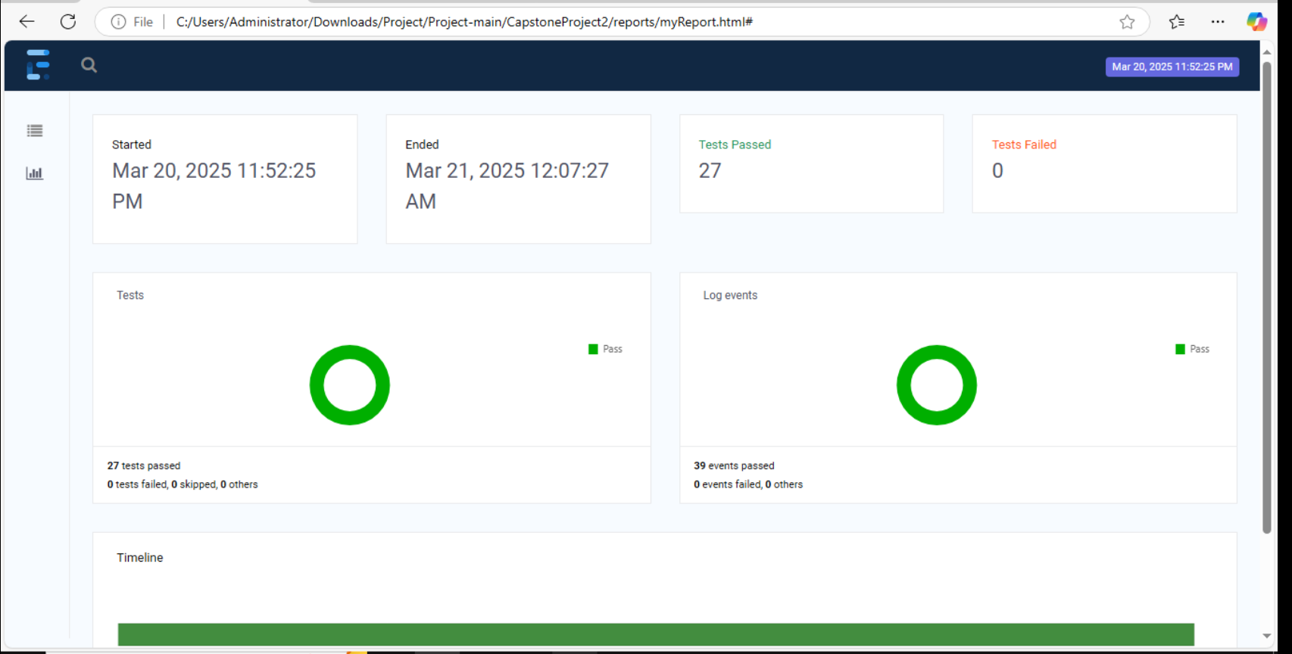
Extent Report

Slide 13
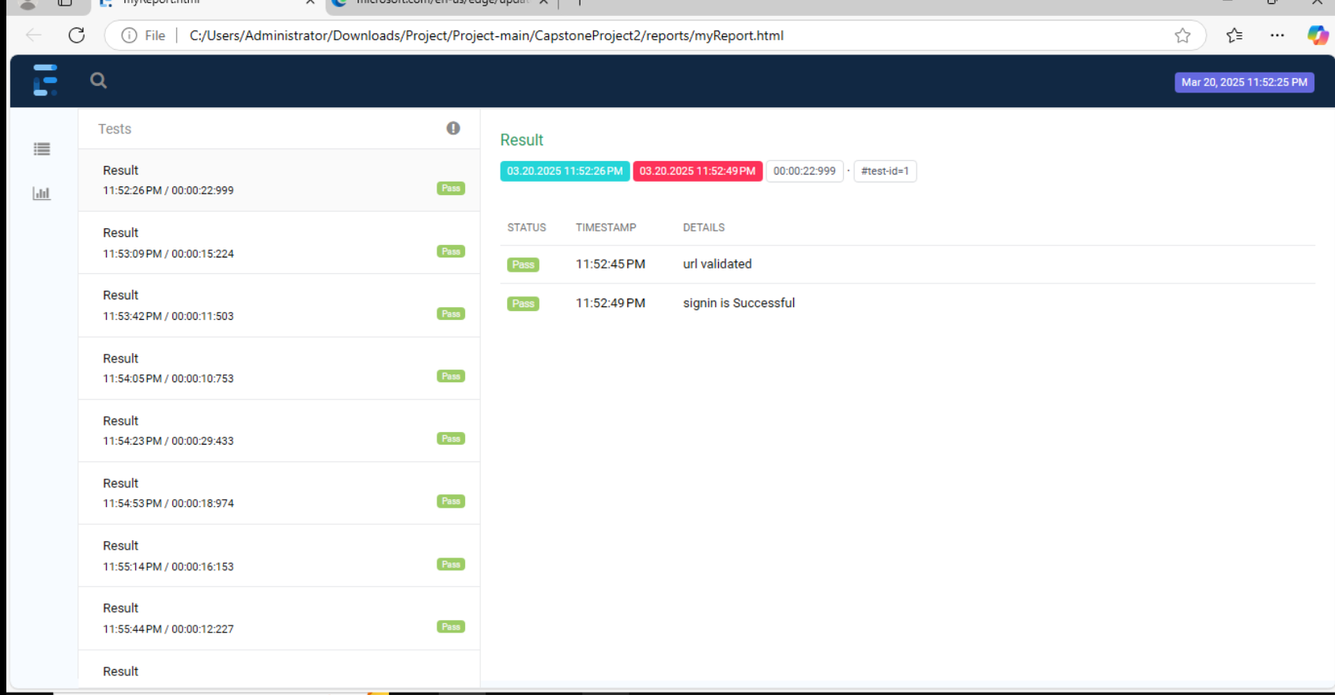

Slide 14
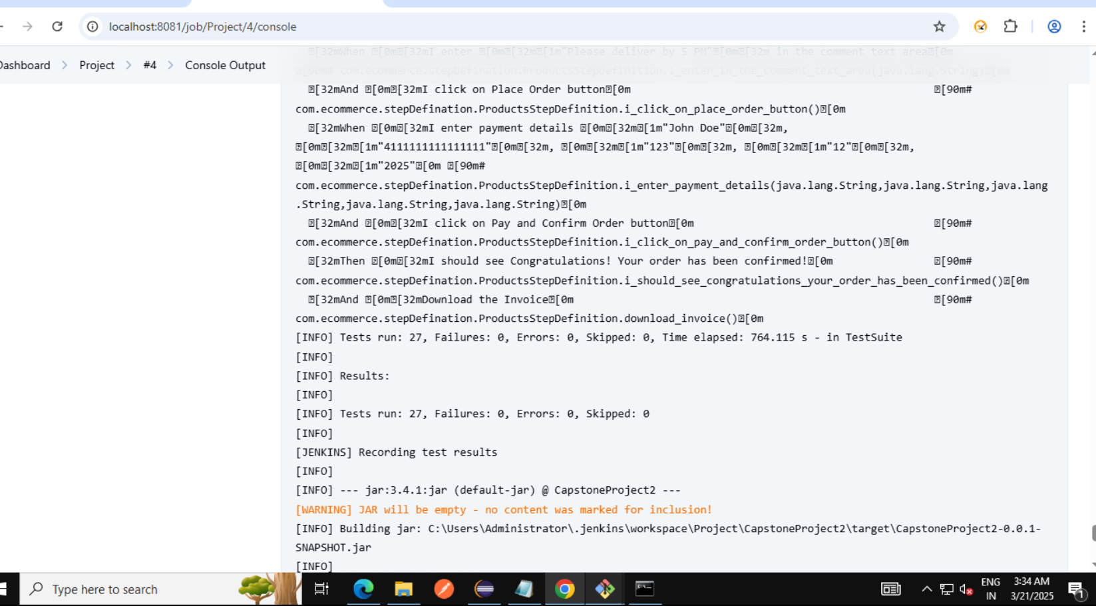
Jenkins

Slide 15
Conclusion
Successfully implemented a hybrid automation framework.
Improved test coverage with 26 automated test cases.
Used best coding practices for maintainability and scalability.
Integrated with Jenkins & Git for CI/CD pipeline execution.

